Slide 1
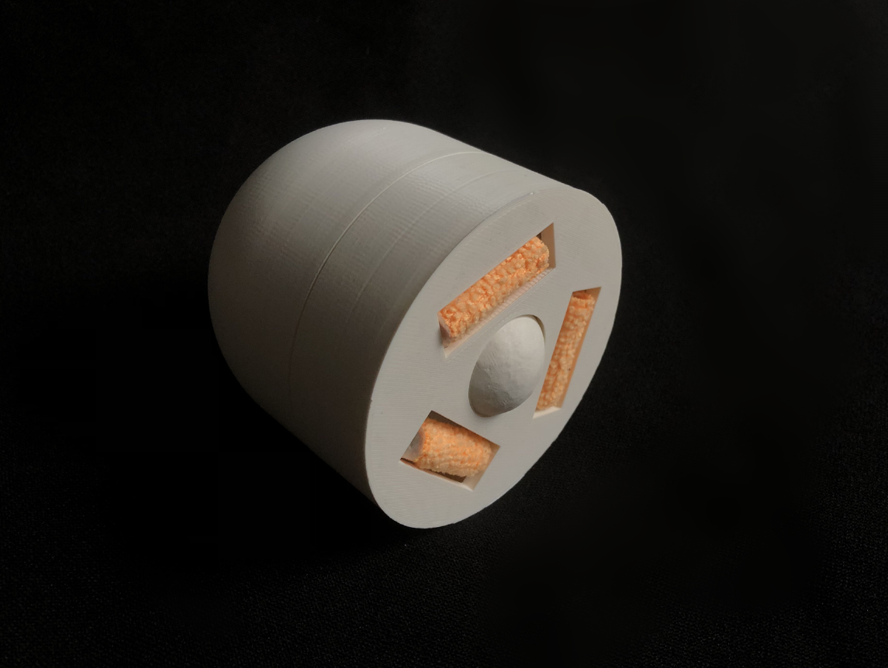
Cat hair cleaning product
Emily Chin
Notes:
Hello, my name is Emily, and I’m here to talk to you about my design. I had first met up with my client via a zoom call, where I had found her problem dealing with cat hair.

Slide 2
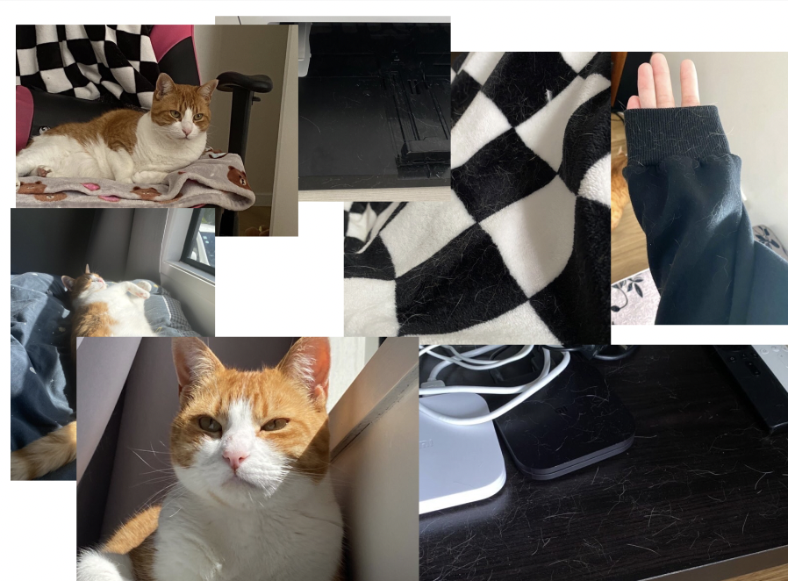
The problem
Cleaning everyday
Avoiding wearing black clothing
Computer broke because of the amount of cat hair
Notes:
Problem of cat hair, something that she's been dealing with on a day to day basis
Specifically she started to avoid wearing black clothing, and had lost a computer due to the amount of cat hair that managed to get inside.

Slide 3
How might we design an attractive product that can quickly clean off cat hair for busy cat-loving university students to help them worry less about having cat hair on themselves and their surroundings?
Notes:
Came to a how might we statement

Slide 4
How might we design an attractive product that can quickly clean off cat hair for busy cat-loving university students to help them worry less about having cat hair on themselves and their surroundings?
Notes:
Attractive
- That would hide the collected cat hair, visually appealing
Quickly
- Efficient and help save time

Slide 5
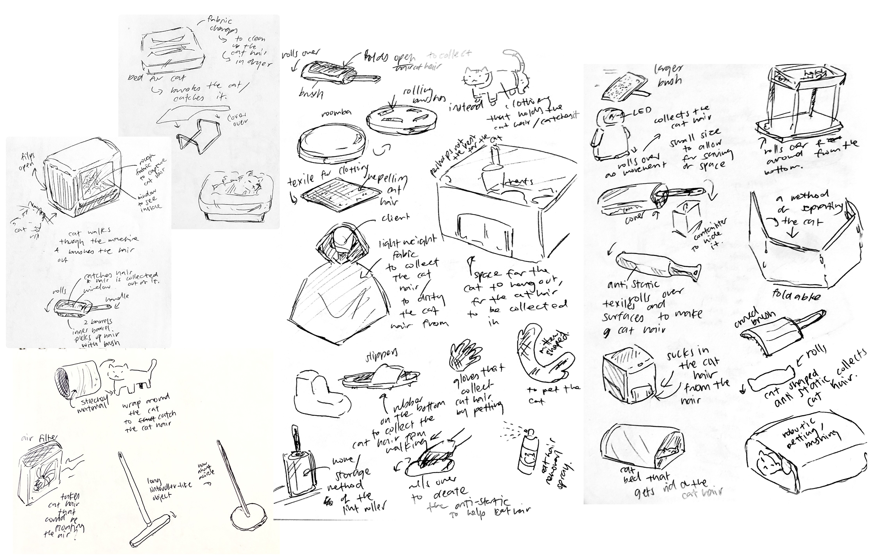
Notes:
Ideate based on the hmw statement with sketches and ideas

Slide 6
Notes:
Three main ideas to later prototype and define

Slide 7
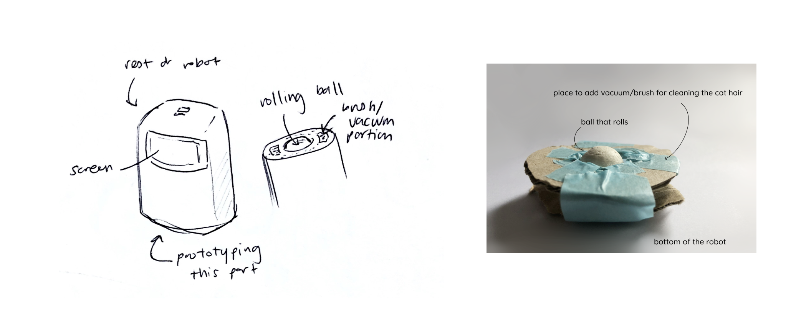
Prototypes
Robot Vacuum for Cat hair
Notes:
Using the idea of lint rollers, how they roll around and preexisting
Looking into pre-existing products that tackle the problem of cleaning up cat ahir
I had combined a few of the ideas that i had then prototyped, and then combined them to create the final product (artififact)

Slide 8
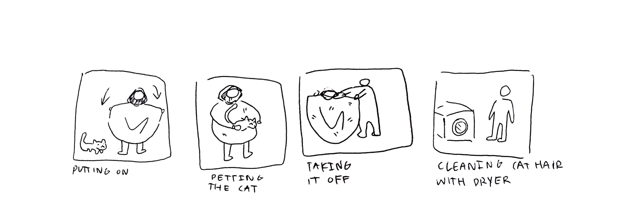
Prototypes
Clothing cover-up
Notes:
Using the idea of lint rollers, how they roll around and preexisting
Looking into pre-existing products that tackle the problem of cleaning up cat ahir
I had combined a few of the ideas that i had then prototyped, and then combined them to create the final product (artififact)

Slide 9
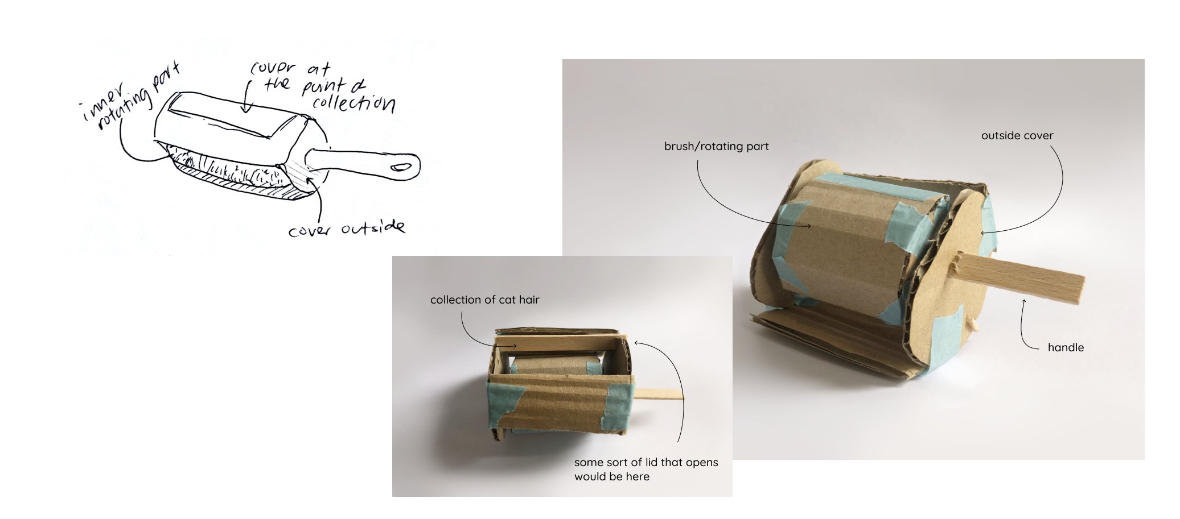
Prototypes
Brush/Lint roller fusion
Notes:
Using the idea of lint rollers, how they roll around and preexisting
Looking into pre-existing products that tackle the problem of cleaning up cat ahir
I had combined a few of the ideas that i had then prototyped, and then combined them to create the final product (artififact)

Slide 10
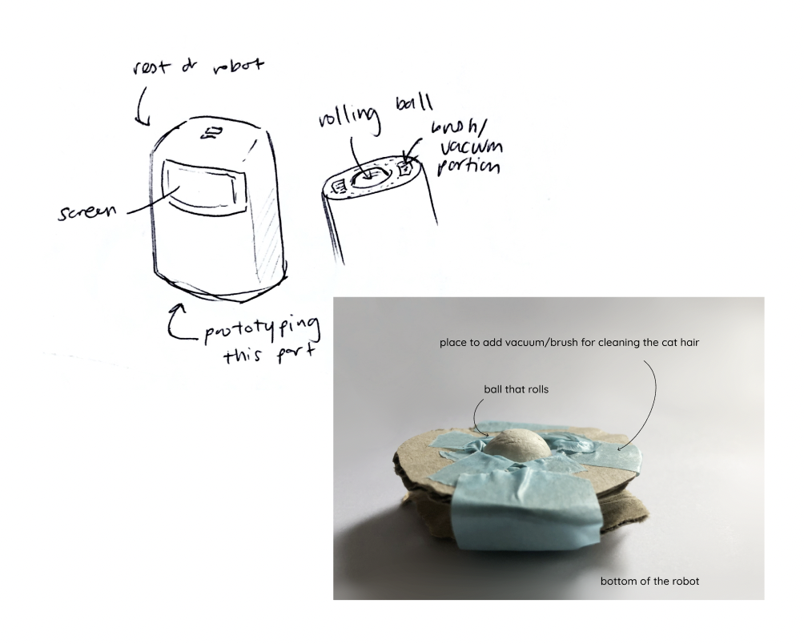
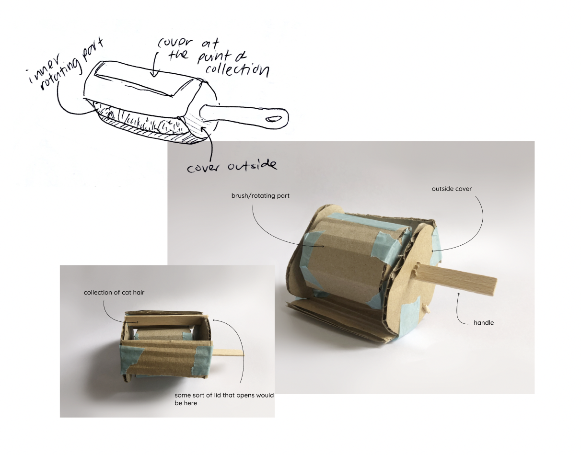
Prototypes
+
Robot Vacuum for Cat hair
Brush/Lint roller fusion
Notes:
From the three, I liked the prototype of 2 of them and created my

Slide 11
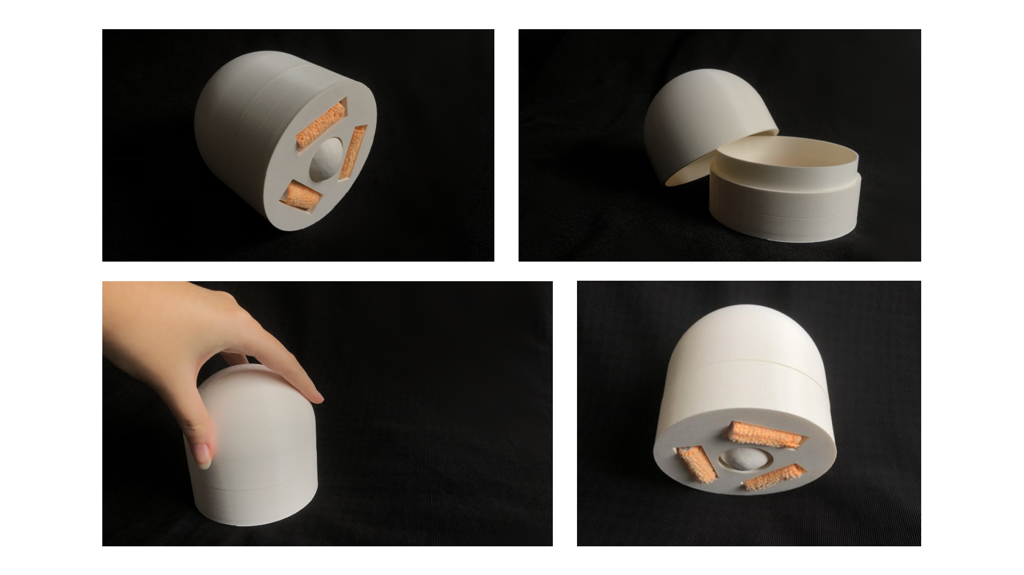
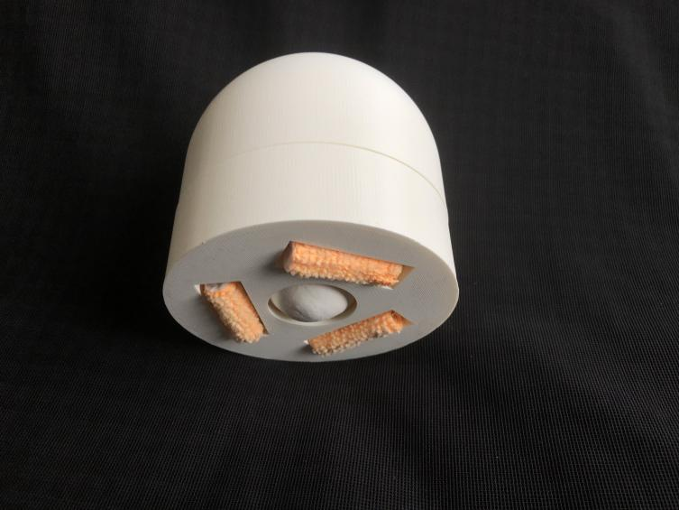
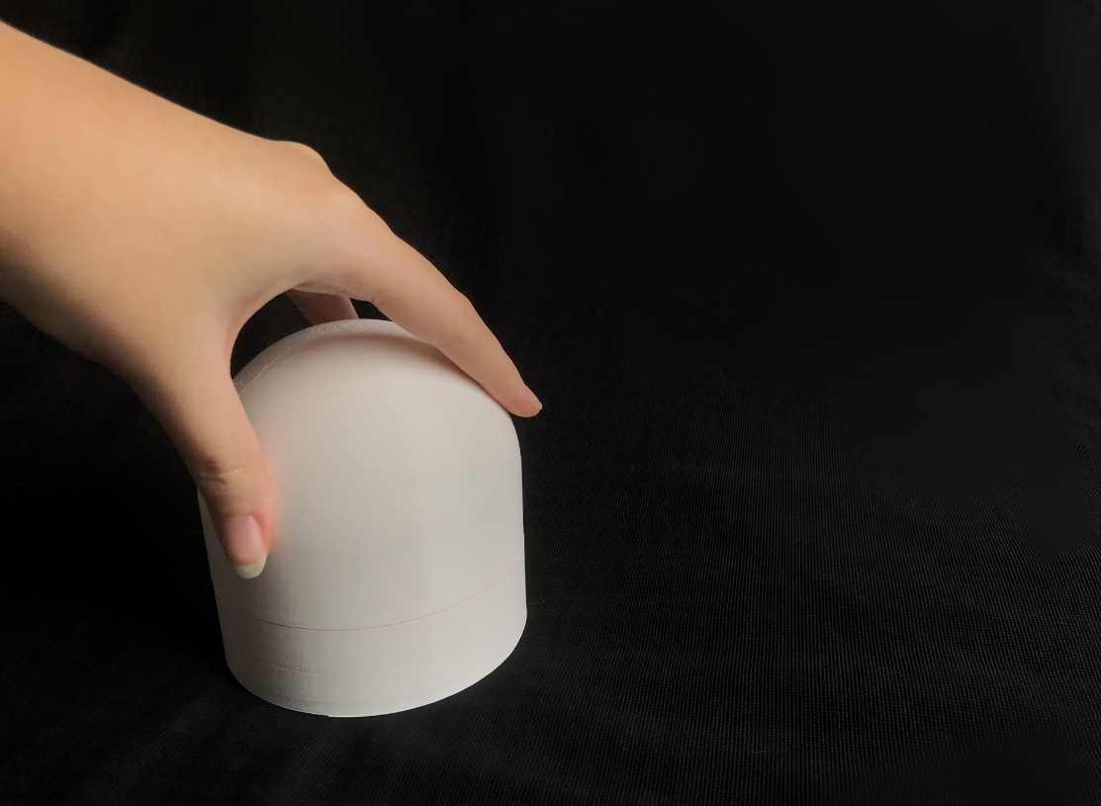
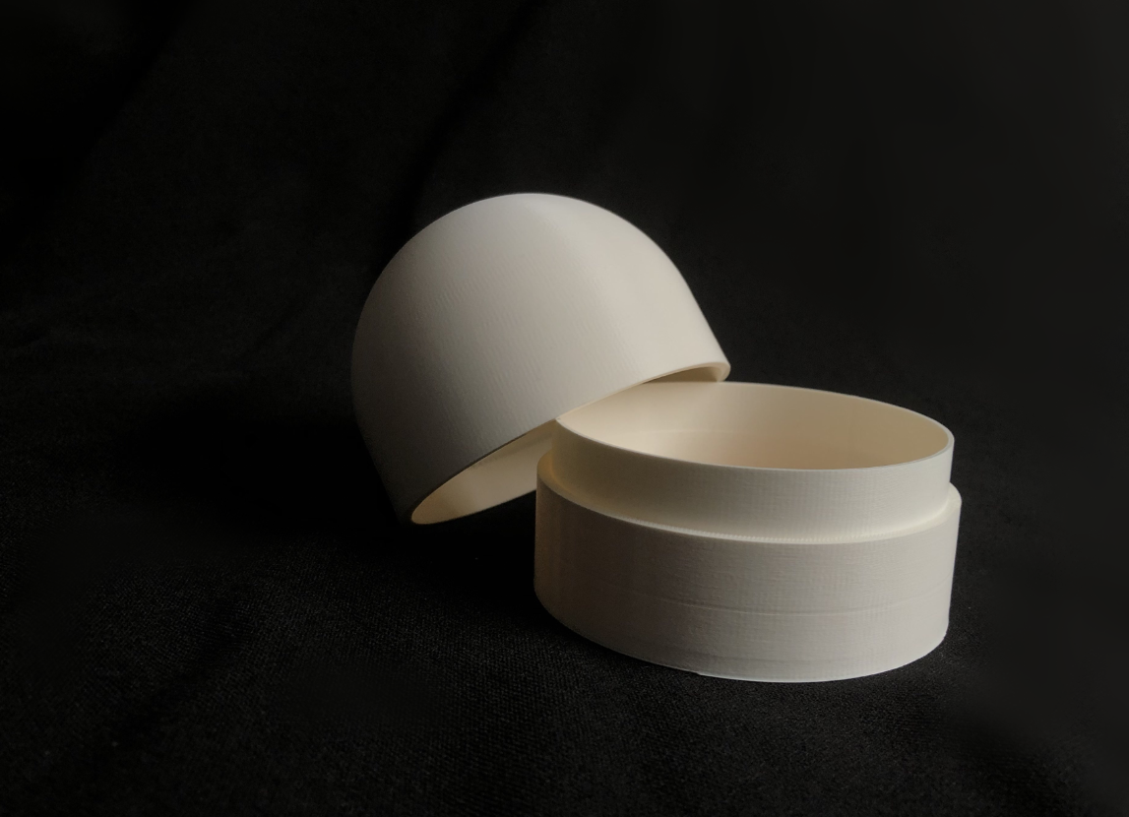
Final design
Notes:
Combined to create my final design which is a 3d printed model shown here

Slide 12
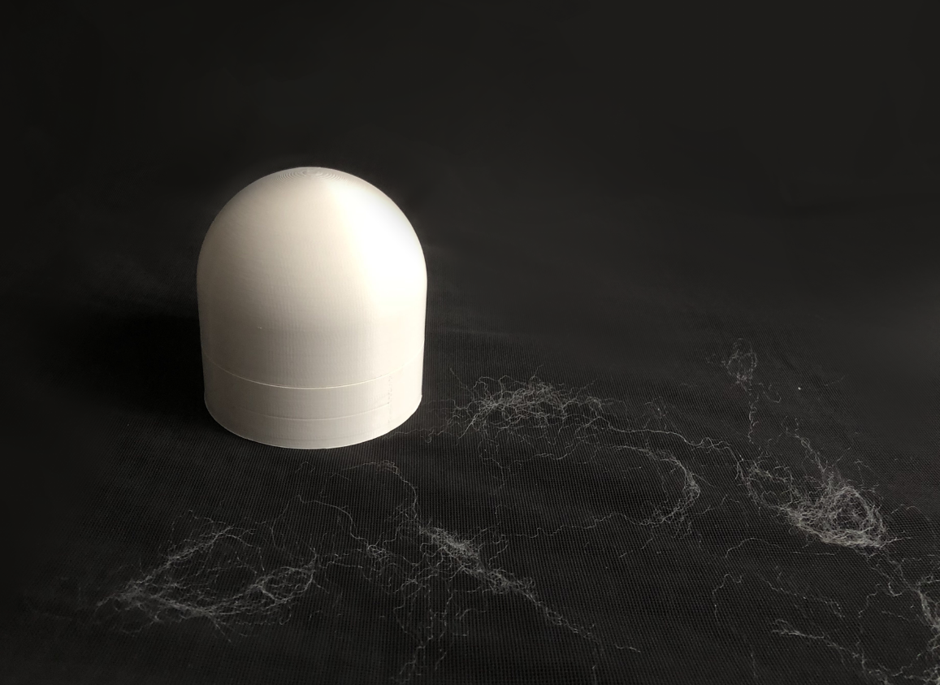
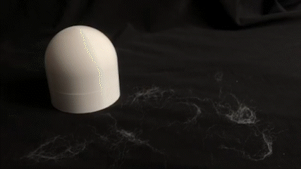
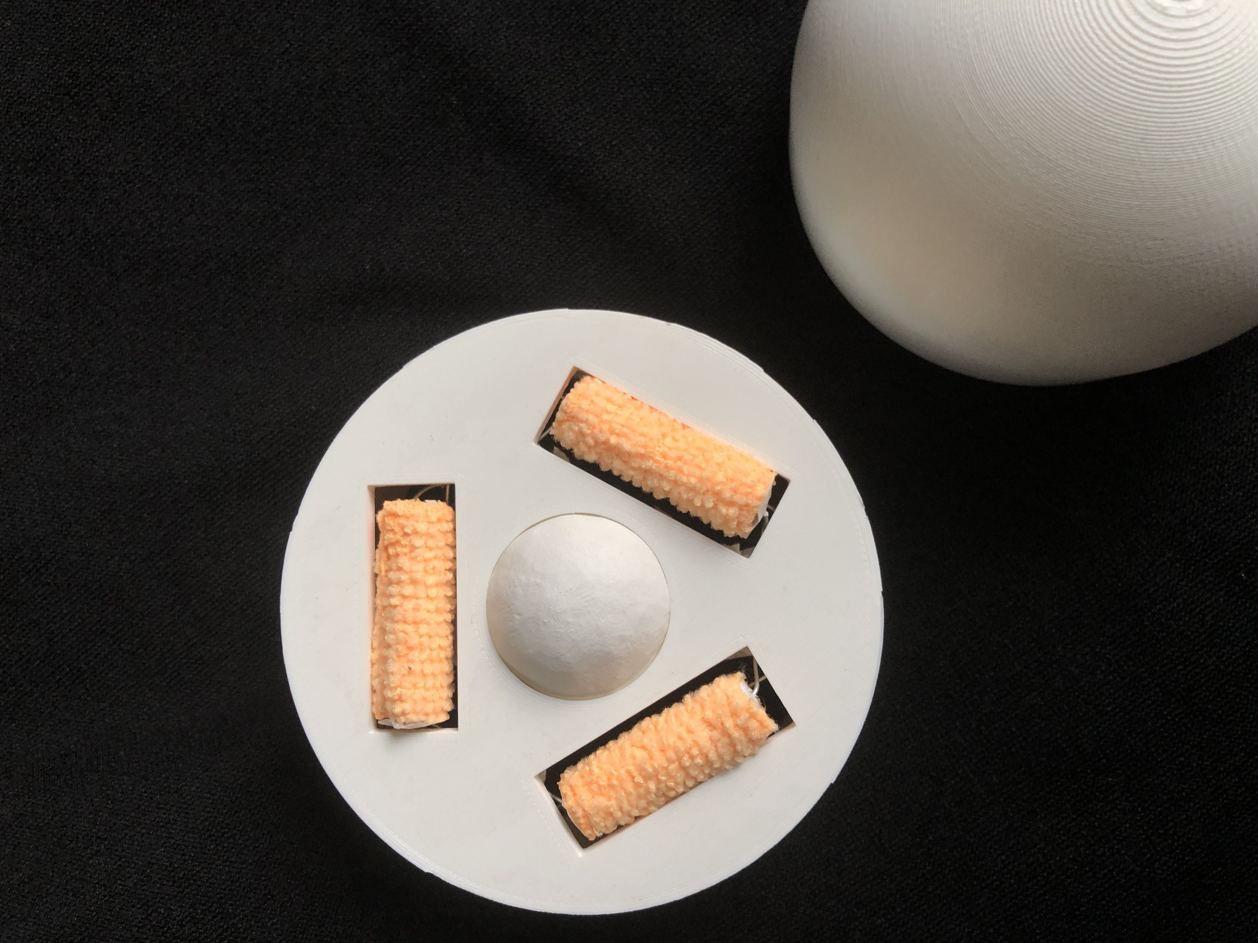
Final design
Notes:
It works by rolling on surfaces with the ball, picking up cat hair with the orange rollers.

Slide 13
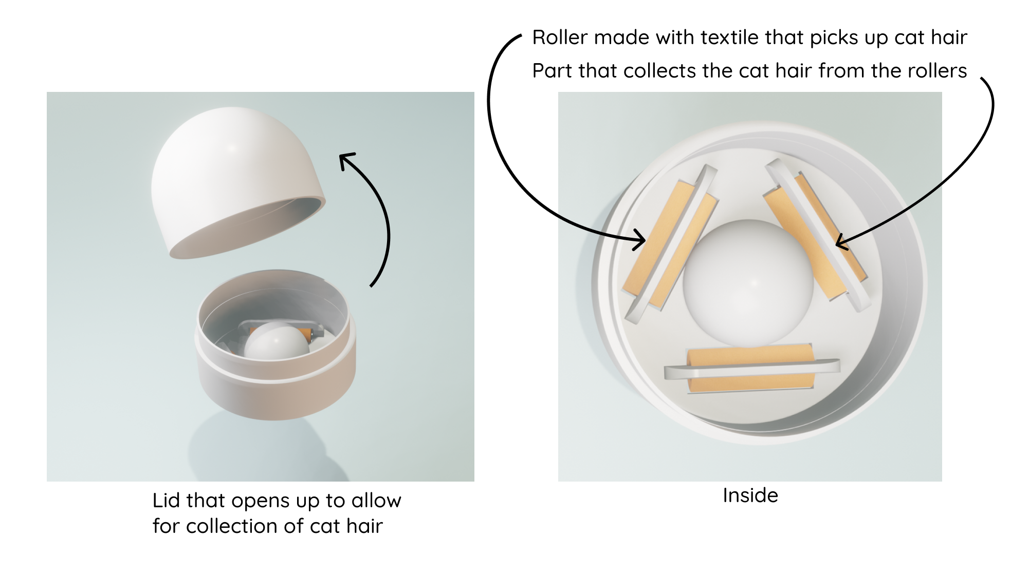
Final design
Notes:
It has three rollers to pick up from any direction
The texile used on the rollers pick up the cat hair in one direction and is deposisted from in the opposite direction

Slide 14
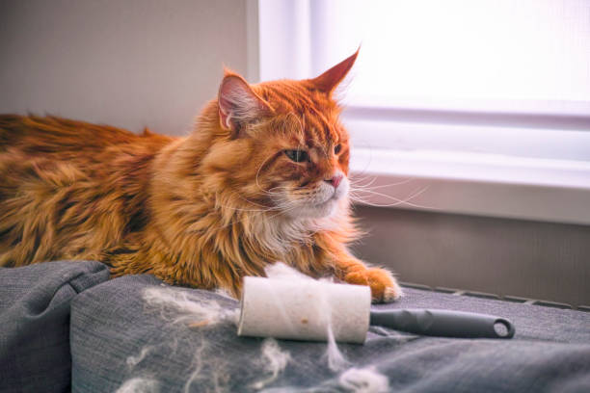
Why not Lint rollers?
Popular choice for cat owners
Unsustainable
Made from polypropylene (PP) plastic
Not as attractive
Credit: iStock/Ekaterina79
Notes:
From cat owners I had talked to, lint rollers were a popular choice, however it is ;
Single use lint rollers arent reusable - made with plastic-coated around
Plastic which isnt easily biodegradable
Made out of appear tape rolled on plastic brush
Made Polypropylene - which takes 20-30 years to decompose
Aprox Millions of these are thrown out
That’s why I believe my design is more attractive and sustainable than whats already out there

Slide 15
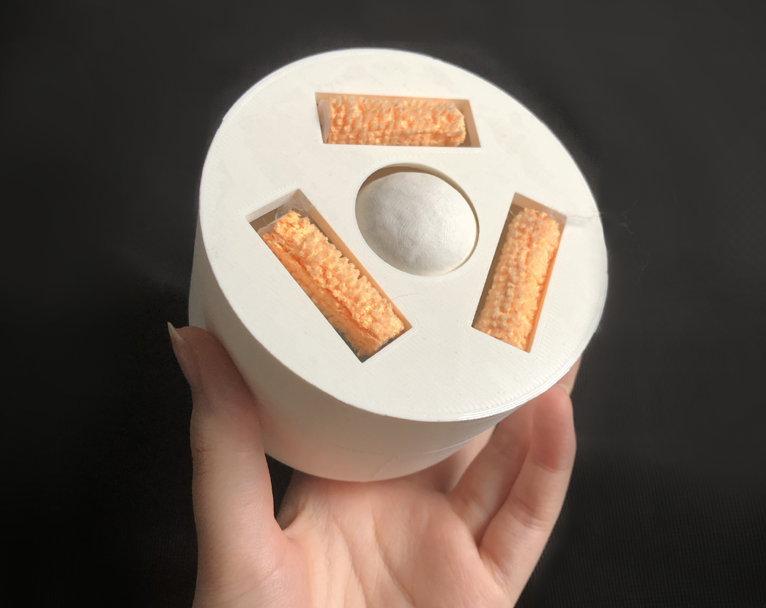
Feedback on the final design
Client feedback
“awesome”
The rollers were too small
Improvements
The roller size and surface area
Movement
Notes:
I had then shared my design with my client, wher she told me it looked awesome, and it was something that she hadn’t seen before. She gave back feedback on how the size of the rollers looked small, and not big enough to collect up the cat hair from my client cat shedding. From this I would want to improve on the design by creating a larger surface area on the bottom of the design.
I would also want to add improvements with the design on the movement, to make it smoother on the edges, making it more stable on the bottom as its more easily to be off balanced due to the shape.

Slide 16
Thank you!

